Slide 1





Data Definition and Data Types
Managing DBs using IDEs
Data Types
SoftUni Team
Technical Trainers
SQL
Software University
http://softuni.bg

Slide 2

Table of Contents
Data Types
Database Modeling
Basic SQL Queries and Table Customization
Deleting Data and Structures

Slide 3
Questions
sli.do #CSharpDB

Slide 4
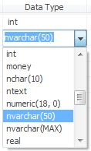

Data Types in SQL Server

Slide 5
Data Types in SQL Server
Numeric
bit (1-bit), integer (32-bit), bigint (64-bit)
float, real, numeric(scale, precision)
money – for money (precise) operations
Strings
char(size) – fixed size string
varchar(size) – variable size string
nvarchar(size) – Unicode variable size string
text / ntext – text data block (unlimited size)

Slide 6
Data Types in SQL Server (2)
Binary data
binary(size) – fixed length sequence of bits
varbinary(size) – a sequence of bits, 1-8000 bytes or max (2GB)
Date and time
date – date in range 0001-01-01 through 9999-12-31
datetime – date and time with precision of 1/300 sec
smalldatetime – date and time (1-minute precision)

Slide 7


Database Modeling
Data Definition using Management Studio

Slide 8
Working with Object Explorer
Object Explorer is the main tool to use when working with the database and its objects
Enables us:
To create a new database
To create objects in the database (tables, stored procedures, relationships and others)
To change the properties of objects
To enter records into the tables

Slide 9
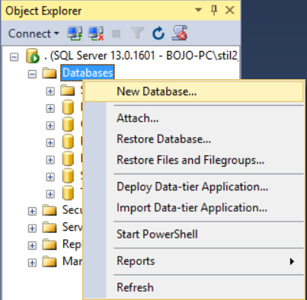
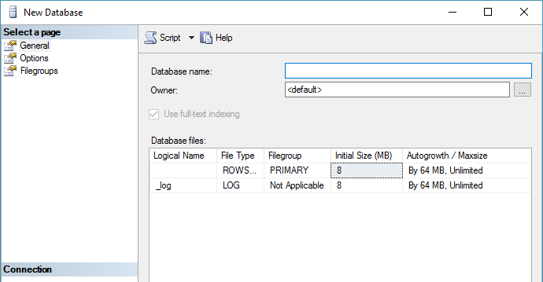
Creating a New Database
Select New Database from the context menu under "Databases"
You may need to Refresh [F5] to see the results

Slide 10
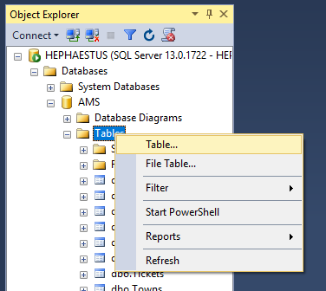
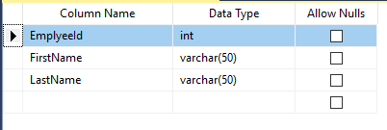
Creating Tables
From the context menu under "Tables" inside the desired database
Table name can be set from its Properties [F4] or when it is saved

Slide 11
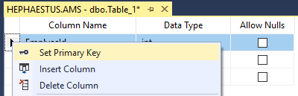
Creating Tables (2)
A Primary Key is used to uniquely identify and index records
Setting primary key on a column:

Slide 12
Creating Tables (3)
Identity means that the values in a certain column are auto incremented for every newly inserted record
These values cannot be assigned manually
Identity Seed – the starting number from which the values in the column begin to increase.
Identity Increment – by how much each consecutive value is increased

Slide 13
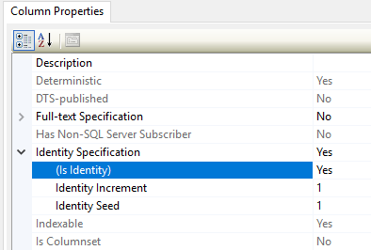
Creating Tables (4)
Setting an identity through the "Column Properties" window:

Slide 14
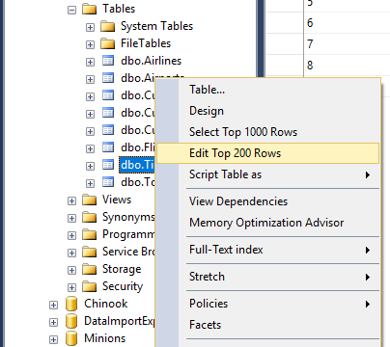
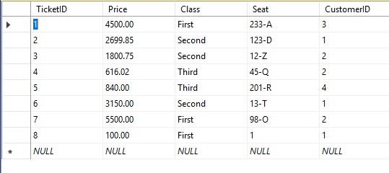
Storing and Retrieving Data
We can add, modify and read records with Management Studio
To insert or edit a record, click Edit from the context menu
Enter data at the end
to add a new row

Slide 15
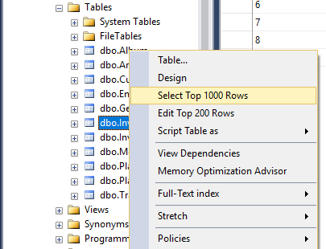
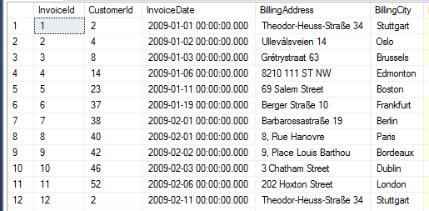
Storing and Retrieving Data (2)
To retrieve records, click Select from the context menu
The received information can be customized with SQL queries

Slide 16
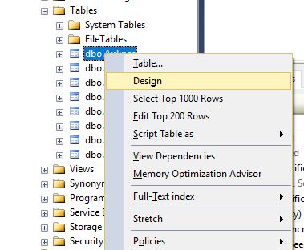
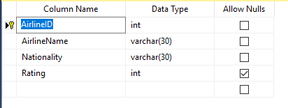
Altering Tables
You can change the properties of a table after it's creation
Select Design from the table's context menu
Changes cannot conflict with existing rules!

Slide 17
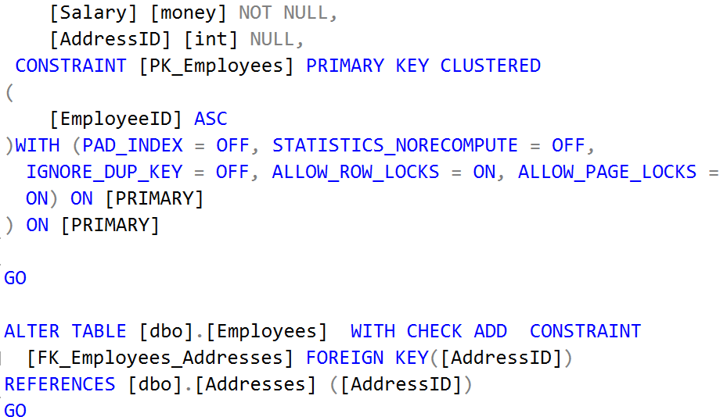
Basic SQL Queries
Data Definition using T-SQL

Slide 18
SQL Queries
We can communicate with the database engine using SQL
Queries provide greater control and flexibility
To create a database using SQL:
SQL keywords are traditionally capitalized
Database name
CREATE DATABASE Employees

Slide 19
Table Creation in SQL
Table name
CREATE TABLE People
(
Id int NOT NULL,
Email varchar(50) NOT NULL,
FirstName varchar(50),
LastName varchar(50)
)
Custom properties
Column name
Data type

Slide 20
Retrieve Records in SQL
To get all information from a table
You can limit the columns and number of records
Table name
SELECT * FROM Employees
Number of records
List of columns
SELECT TOP (5) FirstName, LastName
FROM Employees

Slide 21

Table Customization
Adding Rules, Constraints and Relationship

Slide 22
Custom Column Properties
Primary Key
Identity (auto-increment)
Unique constraint – no repeating values in entire table
Id INT NOT NULL PRIMARY KEY
Id INT IDENTITY PRIMARY KEY
Email VARCHAR(50) UNIQUE

Slide 23
Custom Column Properties (2)
Default value – if not specified (otherwise set to NULL)
Value constraint
Balance DECIMAL(10,2) DEFAULT 0
Kelvin DECIMAL(10,2) CHECK (Kelvin > 0)

Slide 24
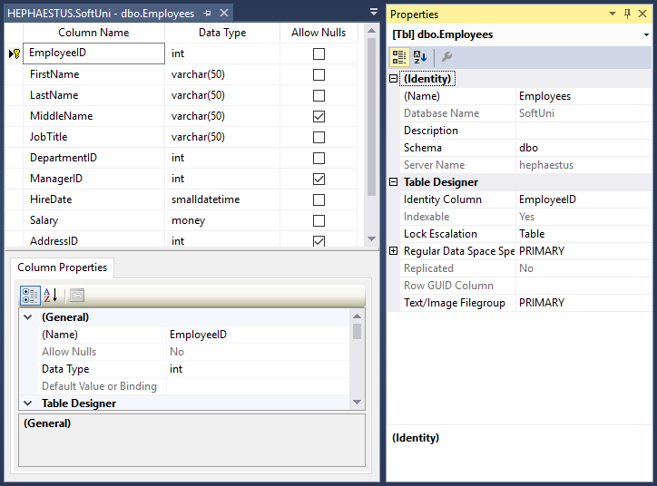
Altering Tables
Changing Table Properties After Creation

Slide 25
Altering Tables Using SQL
A table can be changed using the keywords ALTER TABLE
Add new column
ALTER TABLE Employees
Table name
ALTER TABLE Employees
ADD Salary DECIMAL(15, 2)
Column name
Data type

Slide 26
Altering Tables Using SQL (2)
Delete existing column
Modify data type of existing column
Column name
ALTER TABLE People
DROP COLUMN FullName
ALTER TABLE People ALTER COLUMN Email VARCHAR(100)
Column name
New data type

Slide 27
Altering Tables Using SQL (3)
Constraint name
Add primary key to existing column
Add unique constraint
ALTER TABLE People ADD CONSTRAINT PK_Id
PRIMARY KEY (Id)
Column name(s)
Constraint name
ALTER TABLE People ADD CONSTRAINT uq_Email
UNIQUE (Email)
Columns name(s)

Slide 28
Altering Tables Using SQL (4)
Set default value
Add check constraint
ALTER TABLE People ADD DEFAULT 0
FOR Balance
Default value
Column name
Constraint
Name
ALTER TABLE InstrumentReadings ADD CONSTRAINT PositiveValue
CHECK (Kelvin > 0)
Condition

Slide 29
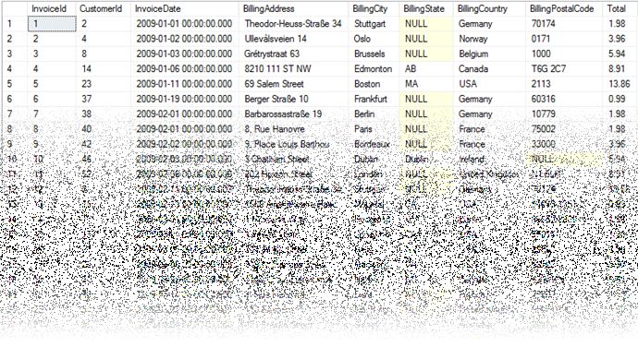
Deleting Data and Structures

Slide 30
Deleting from Database
Deleting structures is called dropping
We can drop:
Keys
Constraints
Tables
Entire databases
Deleting all data in a table is called truncating
Both of these actions cannot be undone – use with caution!

Slide 31
Dropping and Truncating
To delete all the entries in a table
To drop a table – delete data and structure
To drop entire database
TRUNCATE TABLE Employees
Table name
DROP TABLE Employees
Table name
DROP DATABASE AMS
Database name

Slide 32
Dropping and Truncating (2)
Removing constraint from column
This includes primary keys, check constraints and unique fields
To remove default value (if not specified, revert to NULL)
Table name
ALTER TABLE Employees DROP CONSTRAINT pk_Id
Constraint name
ALTER TABLE Employees ALTER COLUMN Clients
DROP DEFAULT
Table name
Columns name

Slide 33
Summary
Table columns have a fixed type
Setting up the database is the last step of the design process
We can use Management Studio to create and customize tables
SQL provides greater control over actions:
CREATE TABLE People
(
Id int NOT NULL,
Email varchar(50) NOT NULL,
FirstName varchar(50),
LastName varchar(50)
)

Slide 34







Data Definition and Data Types
https://softuni.bg/courses/databases-sqlsrv

Slide 35
License
This course (slides, examples, demos, videos, homework, etc.) is licensed under the "Creative Commons Attribution-NonCommercial-ShareAlike 4.0 International" license
Attribution: this work may contain portions from
"Fundamentals of Computer Programming with C#" book by Svetlin Nakov & Co. under CC-BY-SA license
"C# Part I" course by Telerik Academy under CC-BY-NC-SA license

Slide 36





Trainings @ Software University (SoftUni)
Software University – High-Quality Education, Profession and Job for Software Developers
softuni.bg
Software University Foundation
http://softuni.foundation/
Software University @ Facebook
facebook.com/SoftwareUniversity
Software University Forums
forum.softuni.bg

